Slide 1
Holes
A book review by Mia Foley.

Slide 2
First impressions
If you saw this book in a shop or in a library would you pick it up? I probably wouldn’t because the cover isn’t very appealing unlike the story. It just proves that you can’t judge a book by its cover.

Slide 3
The Blurb
Stanley Yelnats isn't too surprised to find himself at Camp Green Lake, digging holes in the dried up lake bed, day after scorching day. After all, his family has a history of bad luck.
The boys at Camp Green Lake must dig one hole each day, five feet deep and five feet across. But what are they digging for? Why did Green Lake dry up? And what do onions and lizards have to do with it all? The answers lie in Stanley's own past...

Slide 4
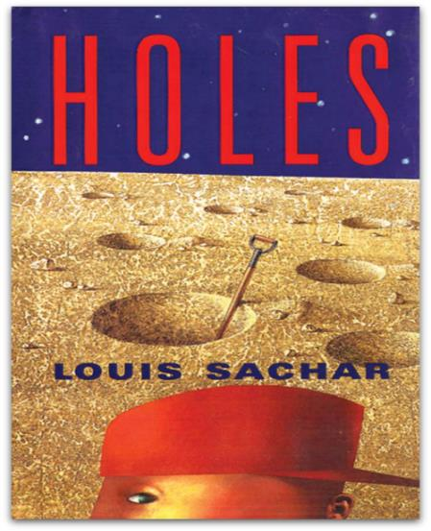
The Story
Basically its about a boy called Stanley Yelnats who is cursed by Madame Zeroni. He is framed for stealing famous shoes owned by a baseball player and sent to “Camp Green Lake” which is correctional facility where they are forced to dig holes to ‘build character’ but there is something not quite right.

Slide 5
Success of this book
This book is very successful. Since it was published in 1998 it has sold over 8 million copies. It has also been made into a movie. It won the 1999 U.S. National book award for young peoples literature and the 1999 Newberry medal for the years “most distinguished contribution to American literature for children.” it was originally called “Wrong place, wrong time, wrong kid.” There is a sequel to this book called “Small Steps” it tells you what happens to the boys after they leave “Camp Green Lake”

Slide 6
General thoughts
For me this book was the perfect combination of humour and sincerity. I would rate this book 9/10, as it has something for everyone and an amazing plot line. I would recommend it to 10 and over as younger than that may not understand it very well.

Slide 7
Thank you for listening

