Slide 1
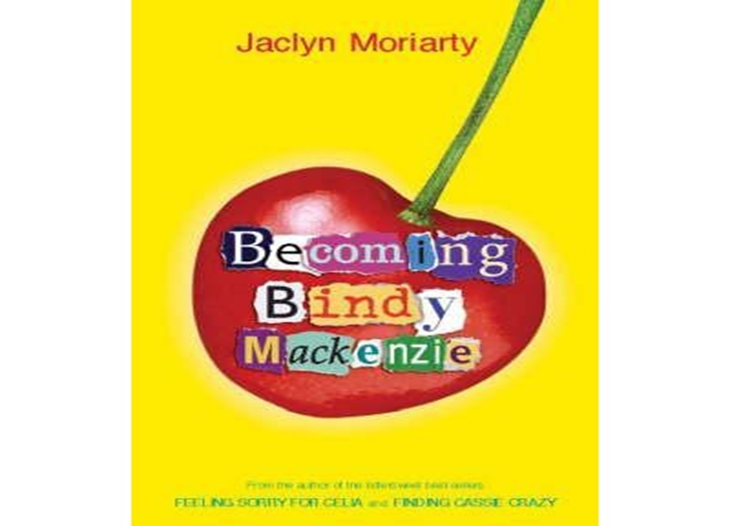
Book Review: Becoming Bindy Mackenzie
By Kate Ballance

Slide 2
Author and Title
This book is called Becoming Bindy Mackenzie.
It is written by a woman called Jaclyn Moriarty.
This book was published in 2006, the publisher is Young Picador.

Slide 3
Summary
This book is about a girl called Bindy Mackenzie. She is the smartest and kindest in Ashbury High. Her world revolves around studying and high grades. Although what she really wants is to have friends.
Bindy is now in year 11 and a new teacher called Try comes into school, Try sets up an FAD (friendship and development) group. Try is Bindy’s FAD teacher. Bindy is put in a group with people who don’t have a good past with Bindy (except for a new boy Finnegan A. Blonde). In the first session of FAD Try does an exercise where people write comments about you. When Bindy gets her sheet back the comments are all negative (except for Finnegan’s).
Bindy gets upset by this and stops being the kind Bindy but a ruthless one instead. Bindy starts to get hallucinations and imagines everyone in her FAD group become venomous animals. People start judging her because she is ruthless.
Over the mid-term, Try gives her a project called “Bindy Mackenzie: A life”, Bindy realizes that being merciful isn’t the Bindy that’s in the project so she changes back to the true Bindy. Her FAD group except her back as well as solving a mystery along the way.

Slide 4
Characters
I liked all the characters but I liked Try the most because she isn’t who you think she is and she’s good at hiding her identity.
There is no one in this book who I disliked very much, although I hated people at times.

Slide 5
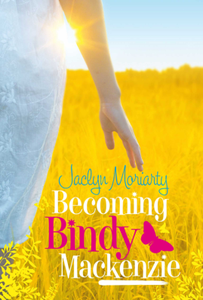
Book cover
The cover of this book is pretty simple. It is yellow with an apple on it, the title is on the apple in a typed designed way. The letters are typed because Bindy types a lot.To be honest I don’t know why there is an apple on it.
There is another book cover but it doesn’t make any sense to me.

Slide 6
Recommendation
This book would be for readers 12 and up. This would also be for girls.
I’d rate this 3 ½ stars out of 5 because nothing really happens until the end and I didn’t really know what it was about.

Slide 7
Thank you for listening.
Any questions?!

